Slide 1

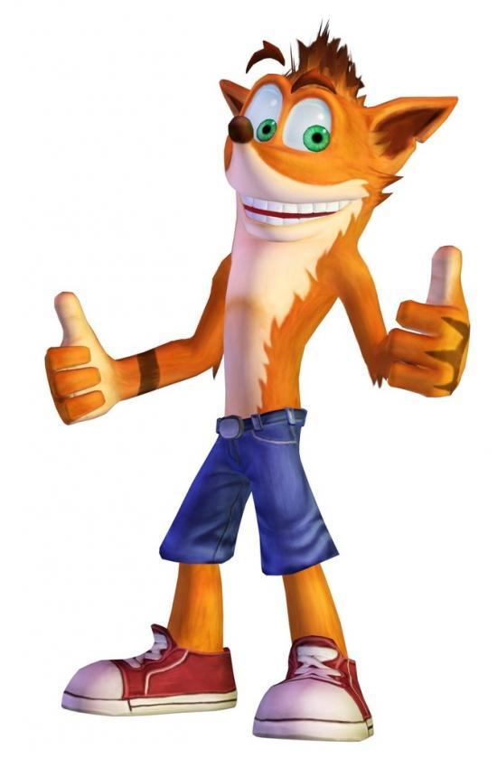
Crash on Titan
Victor Breda
Paula-Alexandra Gitu
Tobias Mersch
Joep Muijrers
Valentin Ringlet
Roy Withaar
Project 1.2, Presentation Second Phase
Notes:
Tobias

Slide 2

Second Phase objectives
We had to:
Improve the solar system simulation
Create a landing module to land on Titan
An open-loop controller
A feedback controller
Add a stochastic wind
Notes:
Tobias
The different objectives for the Second Phase were
to improve the solar system simulation by using a higher-order differential equations solver
create a program to simulate the landing on Titan
Devise an open-loop controller, as well as a feedback controller
Then, in a next step, add stochastic wind and check which controller is still able to successfully land

Slide 3

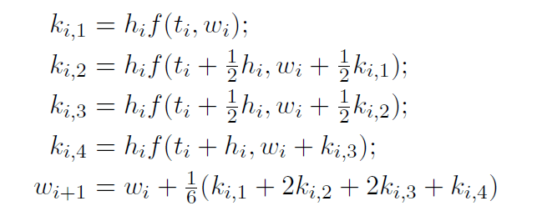
Solar System Improvement
Phase 1:
Euler’s method
Not reaching Titan
Improvements:
Implemented Runge-Kutta Fourth Order
Method for reaching Titan
Notes:
Valentin
In Phase 1, we used Euler’s method to simulate the planets’ motion in the solar system, as well as the motion of the spacecraft. Also, we were not able to reach Titan by shooting the space probe.
The improvements since the second phase are that we implemented a Fourt-order Runge Kutta method for computing the positions of the different bodies in the Solar System, which is more precise than Euler’s method. Additionally, we now have a method for computing an angle to launch the Space probe in order to reach Titan

Slide 4
Controllers for Landing
Open-Loop Controller
the control action performed = independent of the “process output
Example: heater which heats for a given time
For the landing:
constant thrust
To nearly completely counter all other forces
Notes:
Roy
Open-Loop Controller
In an open-Loop Controller, the control action performed is independent of the “process output”, which is the variable being controlled
Example: heater which heats for a given time, without measuring the temperature of the room
How it works for the landing:
The landing module uses a constant thrust at every moment, which would have to be nearly equal in norm to the gravity
Does not take into account anything, so can not counter the wind

Slide 5
Controllers for Landing
Feedback Controller
Opposite of the open-loop controller
For the landing:
Correct the x-position
Done by tilting the landing module
Correct the y-position
Take into account gravity (and optionally also wind)
Determine if we use the thruster
Notes:
Joep
Feedback Controller
Opposite of the open-loop controller, so can take into account all given variables, which are the x- and y-position, the x- and y-velocity, as well as the angle
In this case, that means:
Correct the x-position by modifying the angle of the landing module in order to make the main thruster exert a partially horizontal force
Determine whether we need to use the thruster or not in order to land safely

Slide 6
Wind model
Constant max wind acceleration
Wind
In random direction
Of random force, up to max
Notes:
Victor
In our model, we have a constant setting the maximum acceleration caused by the wind
The generated wind is generated in a random direction and of a randomized intensity between 0 and 1.
We read that the strongest wind measured during the landing of the probe from NASA was 120 m/s, but given that our thruster is set to have a maximum strength of 2500 N, we couldn’t make the maximum wind 120 m/s *(SAY THIS ONLY IF THEY ASK !!! thruster force in Newtons still needs to be divided by the weight of the landing module, which we set to 800 kgs)*

Slide 7
Experiments
Made experiments by modifying parameters, then measured the result
See Excel sheet
Notes:
Valentin
Made experiments by modifying parameters one at a time, then measured the x- and y- positions and velocities, as well as the angle and the time the landing module took to land
See Excel sheet *show the Excel sheet to them*

Slide 8
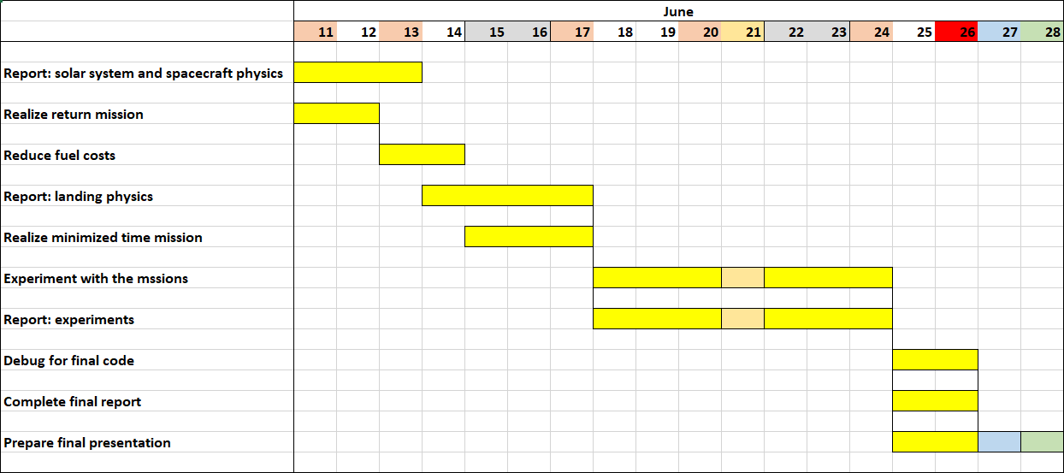
Phase 3 Schedule
Notes:
Paula
Main tasks:
Realizing a return mission from the orbit of the Titan *(ask if it is from the orbit or from the ground of Titan)*
Reduce mission costs by reducing fuel consumption of the travel
Idea: gravitation assist, problem: how to do that, we need to find formulas for it
Search ways to improve the time taken for the travel *(ask if it concerns only the time of travel or also the time of landing)*
Write report
Other tasks:
do experiments with the mission and find which parameters we could do experiments with

Slide 9
Demo
Show demo
Notes:
*Show demo by running program on someone’s computer*

Slide 10


Thanks for your attention !

